Slide 1
Carbonate Sedimentary Particles and their Petrology
Christopher G. St.C. Kendall
803 – 312 1569
kendall@geol.sc.edu

Slide 2
Introduction
This talk provides a background into the origin and character of carbonates sedimentary particles to:
Students
Exploration geologists
Production geologists

Slide 3
Sedimentary rocks are the product of the creation, transport, deposition, and diagenesis of detritus and solutes derived from pre-existing rocks.
Carbonates are sedimentary rocks

Slide 4
Sedimentary rocks are the product of the creation, transport, deposition, and diagenesis of detritus and solutes derived from pre-existing rocks.
Carbonates are sedimentary rocks

Slide 5
Sedimentary Rocks
Detrital/Siliciclastic Sedimentary Rocks
conglomerates & breccias
sandstones
mudstones
Carbonate Sedimentary Rocks
carbonates
Other Sedimentary Rocks
evaporites
phosphates
organic-rich sedimentary rocks
cherts
volcaniclastic rocks

Slide 6
Carbonates House Giant Oil Fields
Porous and permeable carbonates are the major component of the Giant Oil Fields particularly in the Middle East
For this reason an important objective of this talk is to learn how to predict occurrence the subsurface of carbonate facies

Slide 7
Significance of Carbonates & Evaporites
5
Proven Plays with Discovered Reserves
DISCOVERED
Reported (764,000 MBOE)
4
World
Total (1)
56%World Total Reserves in Carbonates
56% Total Reserves in Carbonates
3
64%
Total
Reserves
36%
Trillions BOE
4.1
2
Total in
CaCO3
Fields (2)
1
Carbonate
Fraction
Carbonate Play Association with Evaporite Seal: N = 31
Carbonate Play Association with No Evaporite Seal: N = 45
2.3
Weber & Sarg, 2005
0
(1) USGS World Assessment (2000)
(2) hMobil CATT Study (1999)
Database captured 33% of total discovered reserves in carbonates
41% of plays exhibit an evaporite seal
64% of discovered reserves trapped under an evaporite seal
So evaporites are important?

Slide 8
Lecture Objectives
Carbonate petrography combined with sequence stratigraphy enable determination of depositional settings
Thin sections, cores & outcrop observation identify carbonate allchems or particles
They link to carbonate depositional and diagenetic settings
Emphasis placed on relationship of carbonates to hydrocarbon exploration and production.
Thin section images and photos of hand specimens of carbonates are tied to depositional and diagenetic systems emphasizing ancient and modern depositional systems

Slide 9
Critical Criteria
Mineralogy, external shape, and internal fabric is tied depositional origin of carbonate particles
Hydrocarbon exploration and production depend on prediction of porosity and permeability in conjunction with up dip structural position
Carbonate compositions, facies hierarchies and depositional setting are key to predicting porosity and permeability and so hydrocarbon distribution
This is key to reservoir characterization when this is tied to sequence stratigraphic framework

Slide 10
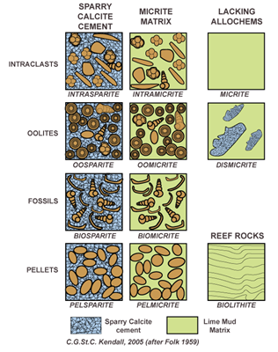
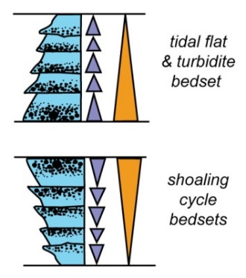
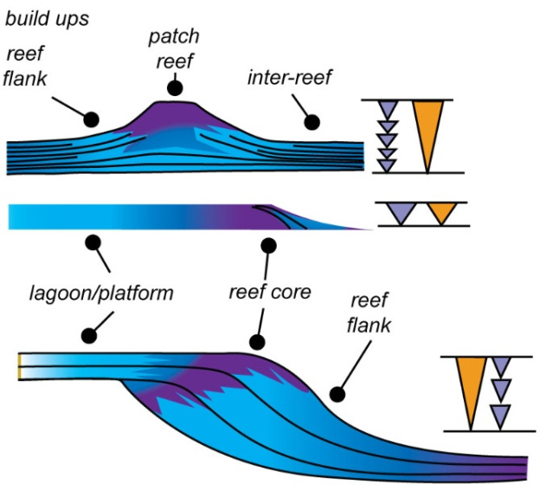
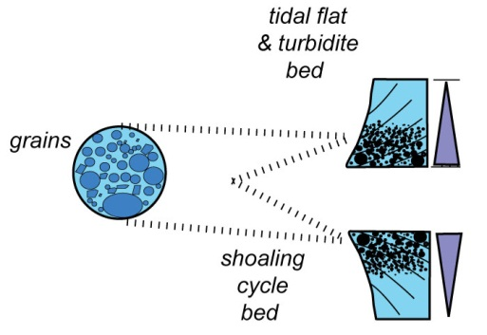
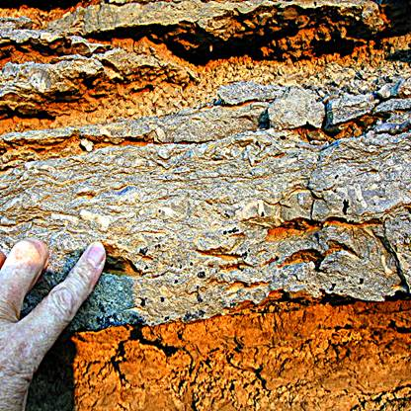
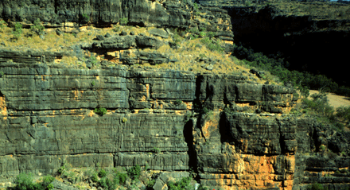
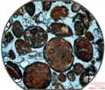
Carbonate Platform Architectural Elements
ALLOCHEMS
CEMENTATION
& DIAGENESIS
,
SEDIMENTARY
STRUCTURES
FAUNA
GRAINS
STACKED BED CYCLES
CYCLES OF
BEDS
REEFS
PROGRADING MARGIN
HST MARGIN
COMPLEX
MARGIN
COMPLEX
PROGRADING MARGIN
SHELF
MARGIN
COMPLEX
SHELF
COMPLEX
ONLAPPING MARGIN
PROGRADING MARGIN

Slide 11
Composition & Depositional Setting
Interpretation and characterization carbonate reservoirs comes from the carbonate components that form them, their depositional systems, and geometric architecture tied to a sequence stratigraphic framework enables:
Prediction of extent and character of facies
Chronology of carbonate facies geometries
Applies no matter geotectonic setting & physical, chemical and biological conditions of depositional setting

Slide 12
Carbonate Hierarchy - Units
Allochems
Lithological components, their cementation & diagenesis
Bedding
Internal character including lithology, geometry, sedimentary structures, and fauna
Stacked Cycles of Beds
Vertical character of beds from varying depositional settings
Margin Complex
Shelf, Shelf margin crest & adjacent basin facies responded to cycles of changing base level
Shelf Complex
Mix of shelf, Shelf margin crest & adjacent basin facies evolving in response to complete & complex cycles of changing base level & paleogeography

Slide 13
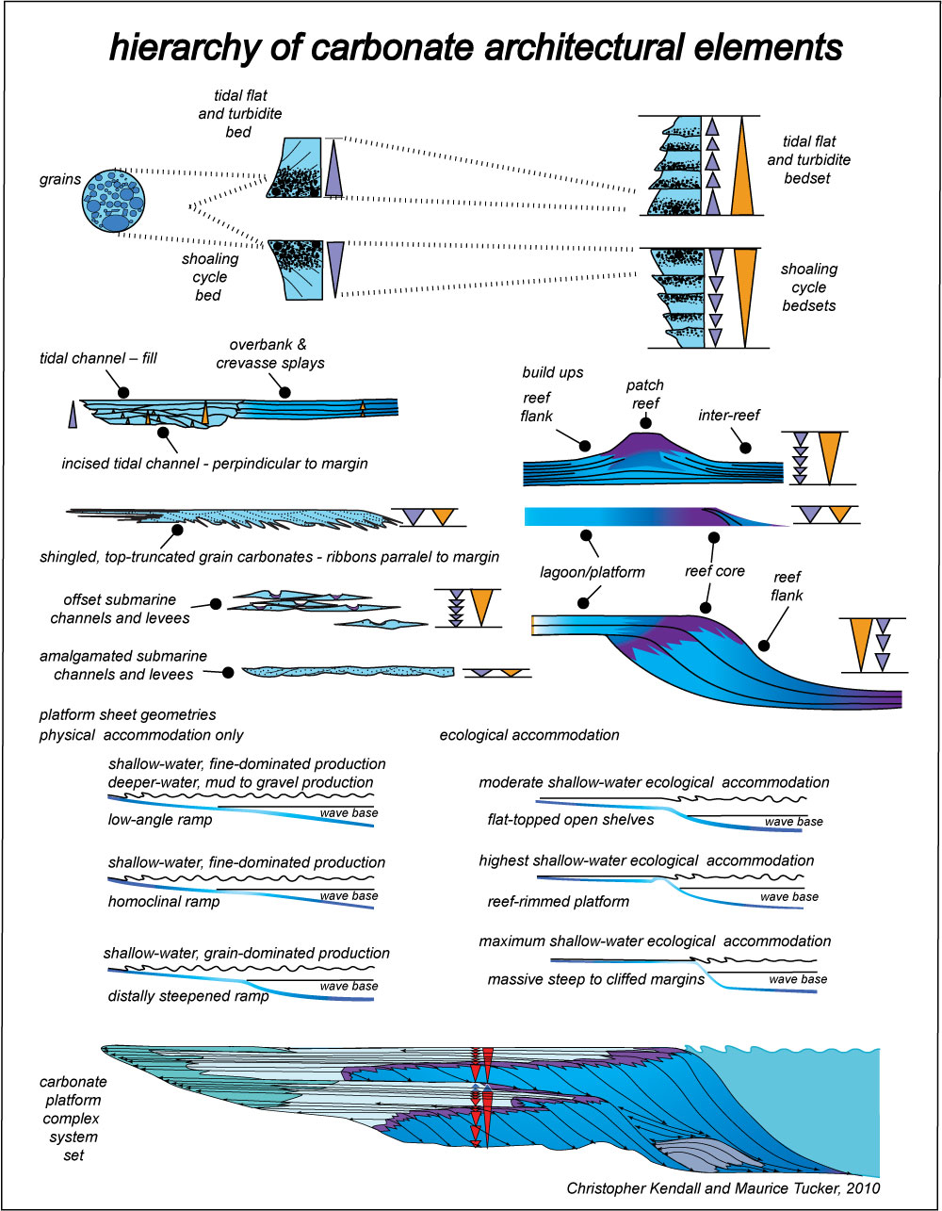
Hierarchy of Carbonate Platform Architectural Elements
Hierarchy of Carbonate Architectural Elements
”Carbonate Hierarchies”
Christopher G. St. C. Kendall

Slide 14
Carbonates and Sedimentary Record

Slide 15
Where & When do Limestones Form?
Shallow Marine –Late Proterozoic to Modern
Deep Marine – Rarer in Ancient & commoner in Modern
Cave Travertine and Spring Tufa – both Ancient & Modern
Lakes – Ancient to Modern

Slide 16
CO₂ - Temperature & Pressure Effect!
High temperatures, low pressure & breaking waves favor carbonate precipitation
CO₂ + 3H₂O = HCO₃⁻¹ + H₃O⁺¹ + H₂O = CO₃⁻² + 2H₃O⁺¹
Carbon dioxide solubility decreases in shallow water and with rising in temperature
At lower pressure CO₂ is released & at higher pressures dissolves
HCO₃⁻¹ and CO₃⁻² are less stable at lower pressures but more stable at higher pressures
HCO₃⁻¹ and CO₃⁻² have lower concentration in warm waters but higher concentrations in colder waters

Slide 17
Calcium Carbonate - Solubility
Note calcium carbonate dissociation: CaCO₃= Ca⁺² + CO₃⁻²
CaCO₃ is less soluble in warm waters than cool waters
CaCO₃ precipitates in warm shallow waters but increasingly soluble at depth in colder waters
CO₂ in solution buffers concentration of carbonate ion (CO₃⁻²)
Increasing pressure elevates concentrations of HCO₃⁻¹ & CO₃⁻² (products of solubility reaction) in sea water
CaCO₃ more soluble at higher pressures & with decreasing temperature

Slide 18
Controls on Carbonate Accumulation
Temperature (climate) -Tropics & temperate regions favor carbonate production: true of ancient too!
Light – Photosynthesis drives carbonate production
Pressure – “CCD” dissolution increases with depth
Agitation of waves - Oxygen source & remove CO₂
Organic activity - CaCO₃ factories nutrient deserts
Sea Level – Yield high at SL that constantly changes
Sediment masking - Fallacious!

Slide 19
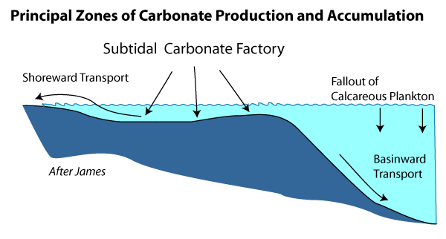
Principle Belts of Carbonate Accumulation

Slide 20
Principle Belts of Carbonate Accumulation
MARGIN
RESTRICTED
OPEN MARINE
SHELF
SLOPE
BASIN

Slide 21
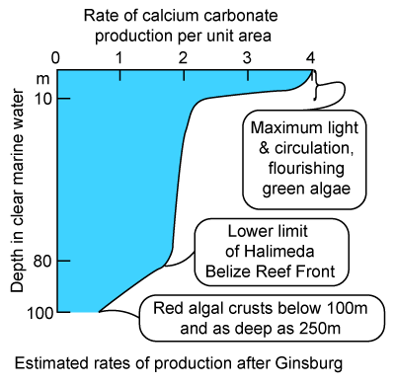
Rates of Carbonate Accumulation & Depth

Slide 22
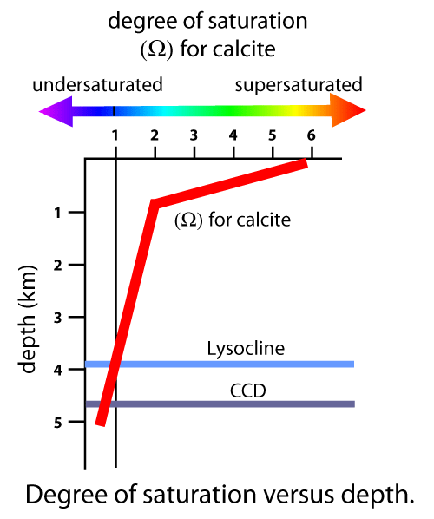
Lysocline and CCD Controls

Slide 23
Limestones – Chemical or Bochemical
Distinction between biochemical & physico-chemical blurred by ubiquitous cyanobacteria of biosphere!
Shallow sea water is commonly saturated with respect to calcium carbonate
Dissolved ions expected to be precipitated as sea water warms, loses CO₂ & evaporates
Organisms generate shells & skeletons from dissolved ions
Metabolism of organisms cause carbonate precipitation

Slide 24
Biological Carbon Pump
Carbon from CO₂ incorporated in organisms through photosynthesis, heterotrophy & secretion of shells
> 99% of atmospheric CO₂ from volcanism removed by biological pump is deposited as calcium carbonate & organic matter
5.3 gigatons of CO₂ added to atmosphere a year but only 2.1 gigatons/year remains; the rest is believed sequestered as aragonite & calcite

Slide 25
Carbonate Mineralogy
Aragonite – high temperature mineral
Calcite – stable in sea water & near surface crust
Low Magnesium Calcite
High Magnesium Calcite
Imperforate foraminifera
Echinoidea
Dolomite – stable in sea water & near surface
Carbonate mineralogy of oceans changes with time!

Slide 26
Controls on Carbonate Accumulation

Slide 27
Source Rock Potential

Slide 28
Evolving Plate Configuration & Setting

Slide 29
Paleozoic Sediments
Paleozoic landward dominantly siliciclastic continental to fluvio-deltaic & glacial sediments while seaward shales & carbonates more common
Oil fields probably sourced from organic rich mfs events
These same organic rich sediments associated with reservoir quality rocks high grade the hydrocarbon potential of these rocks

Slide 30
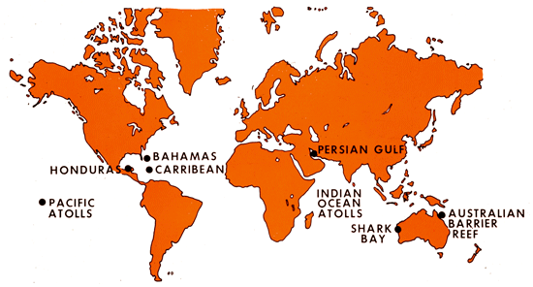
Areas of Modern Carbonate Deposition
TEMPERATE OCEANS
TROPICS
TEMPERATE OCEANS

Slide 31
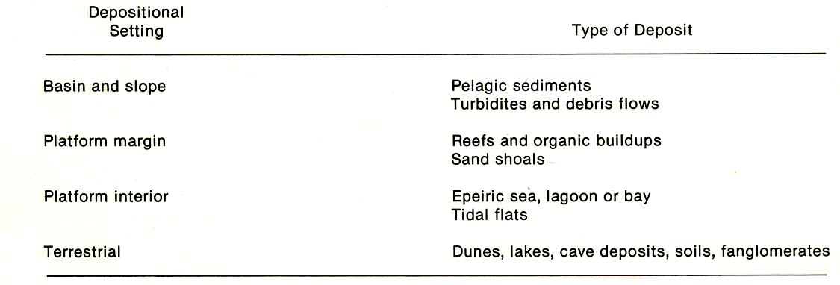
Setting versus Sediments

Slide 32
Factors Controlling Modern Carbonates Facies
Bank Geometry & Topography
Turbulence
Water Quality
Biological Influence
Sea Level Position
Lack of Clastic Sedimentation or Nutrients
”Carbonate Hierarchies”
Christopher G. St. C. Kendall

Slide 33
Controls on Carbonate Accumulation

Slide 34
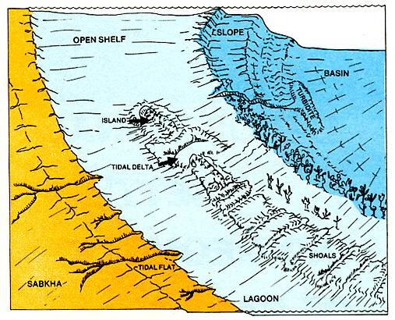
Carbonate Depositional Setting Physiography

Slide 35
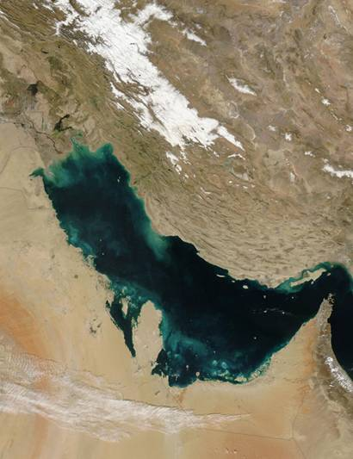
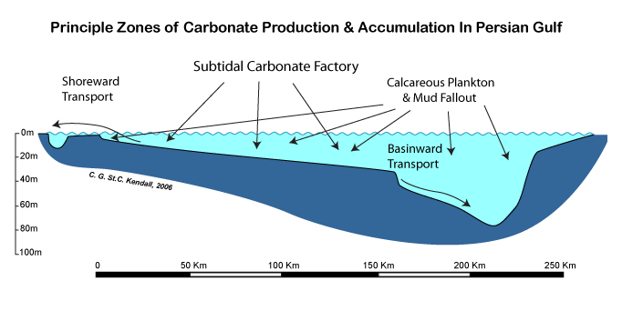
Carbonate Depositional Setting Physiography
Basin
Ramp
Open
Shelf
Restricted
Shelf

Slide 36
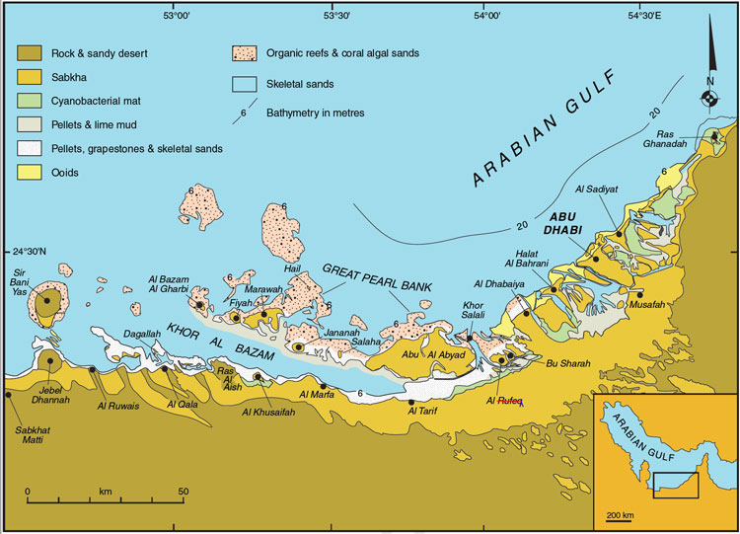
Carbonate Facies of UAE

Slide 37
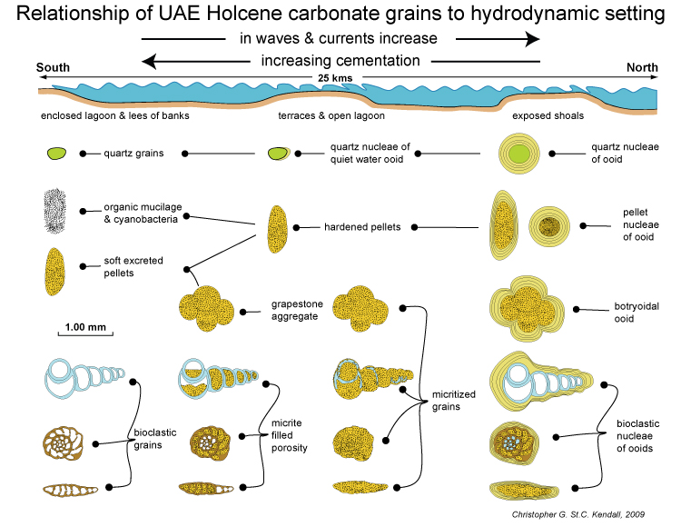
Carbonate Facies of UAE

Slide 38
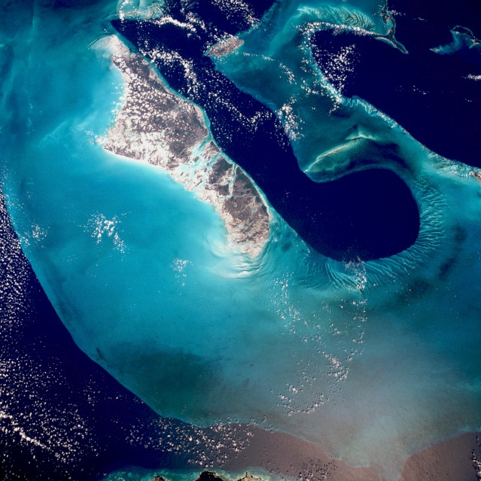
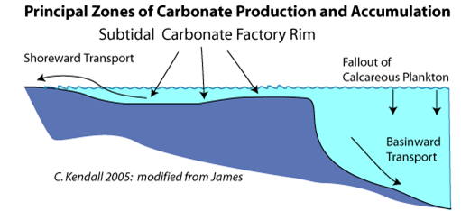
Carbonate Depositional Setting Physiography
Open
Shelf
Rim
Basin
Restricted
Shelf

Slide 39
Carbonate Depositional Setting Physiography

Slide 40
Carbonate Depositional Setting Physiography
Open
Shelf
Sabkha
Sediments
Basin
Margin
Carbonates
Basinal
Clastics
Kendall Photo

Slide 41
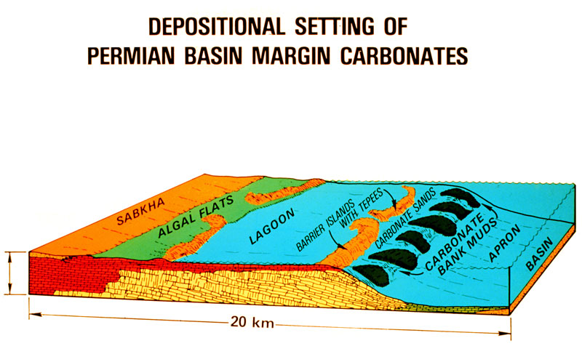
Depositional Settings of Permian Basin

Slide 42
Depositional Settings of Permian Basin
Open Marine Shelf
Restricted
Tidal Flats
& Lagoon
Margin
Slope
Basin
Fill

Slide 43
Carbonate Components – The Key
Interpretation of depositional setting of carbonates is based on
Grain types
Grain packing or fabric
Sedimentary structures
Early diagenetic changes
Identification of grain types commonly used in subsurface studies of depositional setting because, unlike particles in siliciclastic rocks, carbonate grains generally formed within basin of deposition
NB: This rule of thumb doesn’t always apply

Slide 44
Carbonate Particles
Subdivided into micrite (lime mud) & sand-sized grains
These grains are separated on basis of shape & internal structure
They are subdivided into: skeletal & non-skeletal (bio-physico-chemical grains)

Slide 45
Depositional Settings of Great Bahamas Bank

Slide 46
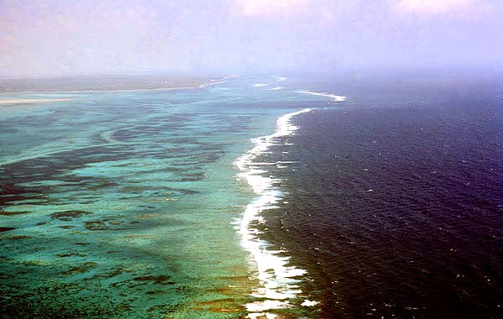
Depositional Settings of Andros Reef Tract

Slide 47
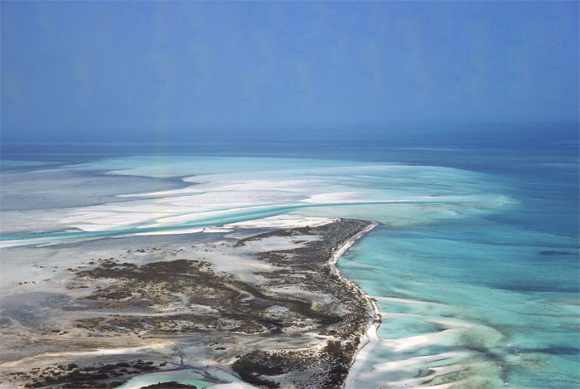
Depositional Settings of Joulters Kay

Slide 48
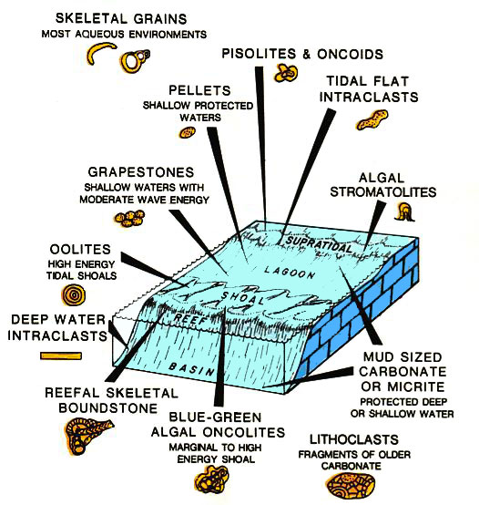
Depositional Settings of Carbonate Grains

Slide 49
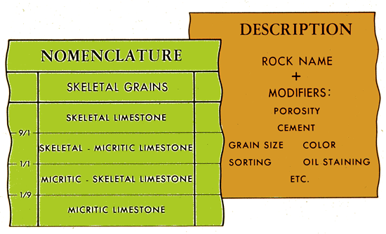
Naming Carbonate Rocks

Slide 50
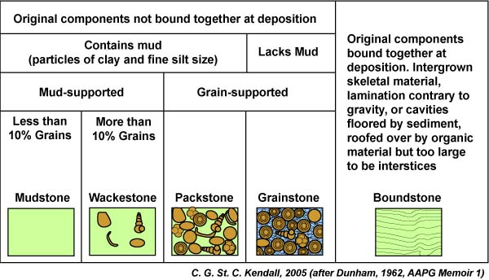
Dunham - Naming Carbonate Rocks

Slide 51
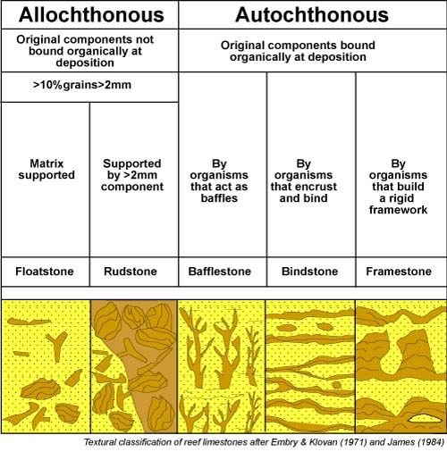
Dunham - Naming Carbonate Rocks

Slide 52
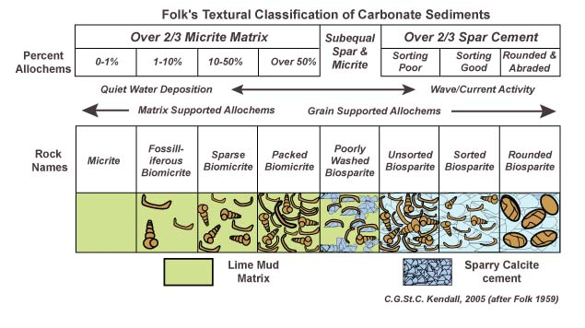
Folk - Naming Carbonate Rocks

Slide 53
Folk - Naming Carbonate Rocks

Slide 54
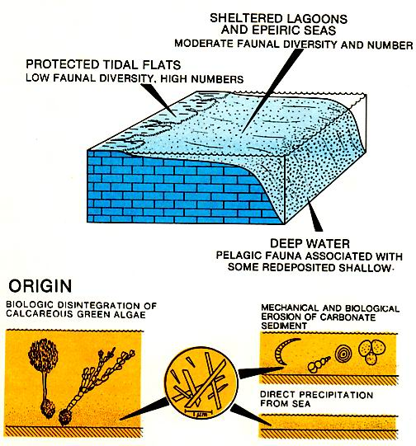
Lime Mud or Micrite

Slide 55
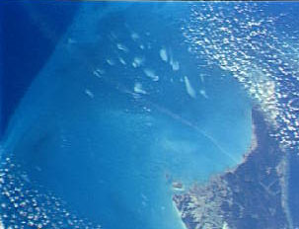
Depositional Settings of Whiting Blooms
WHITING
LIME MUD
ACCUMULATES
ON BANK, OFF BANK
& TIDAL FLATS

Slide 56
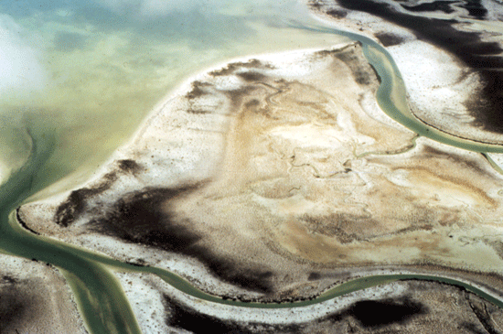
Depositional Settings of Three Creeks - Muds

Slide 57
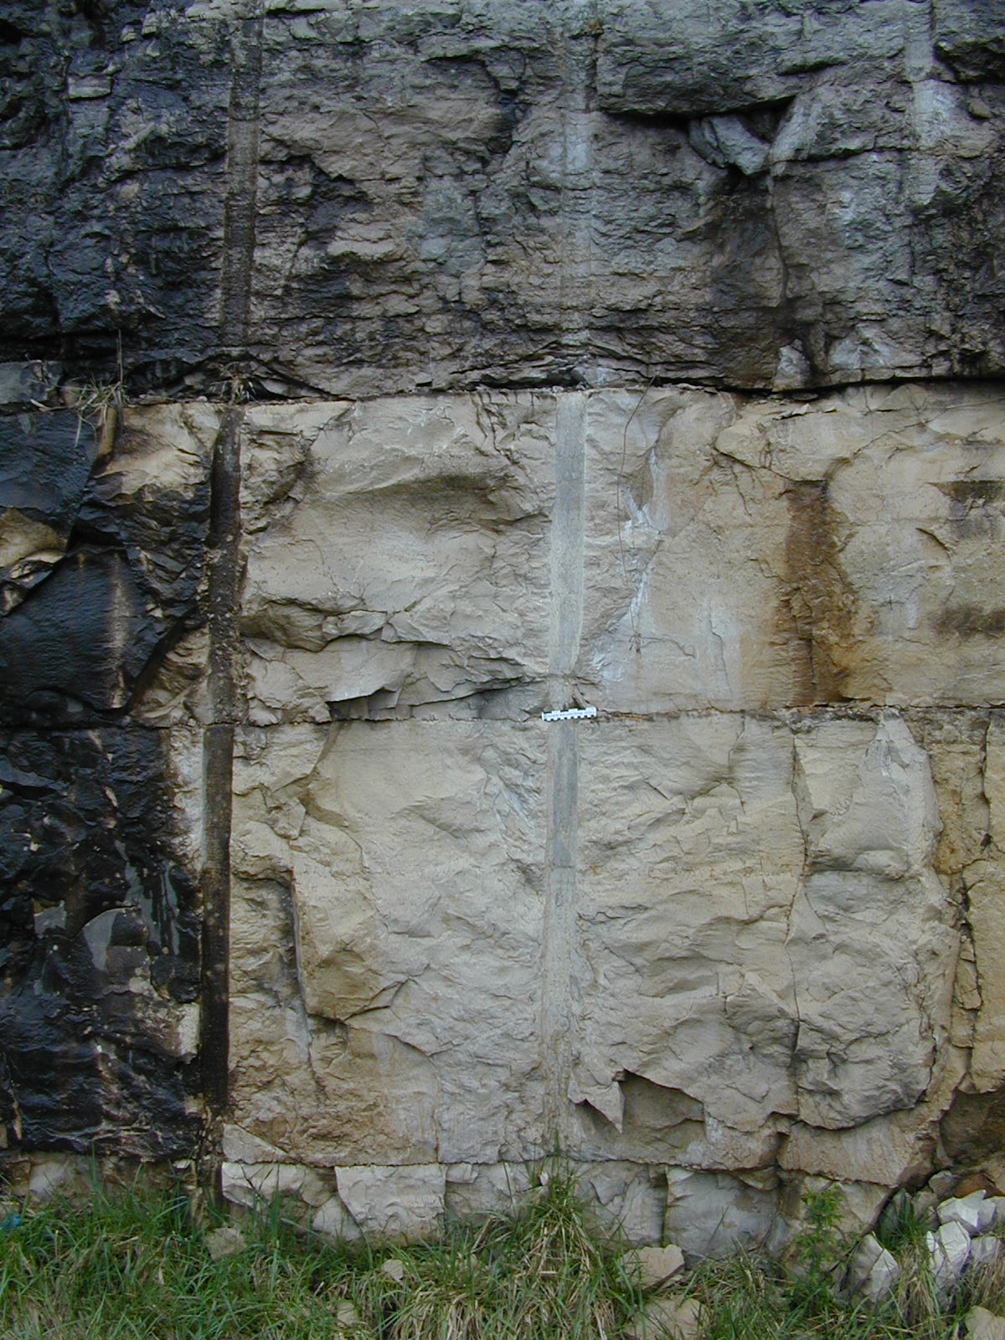
Depositional Settings of Lime Mud
Lime Mud
-
Ordovician
Kentucky

Slide 58
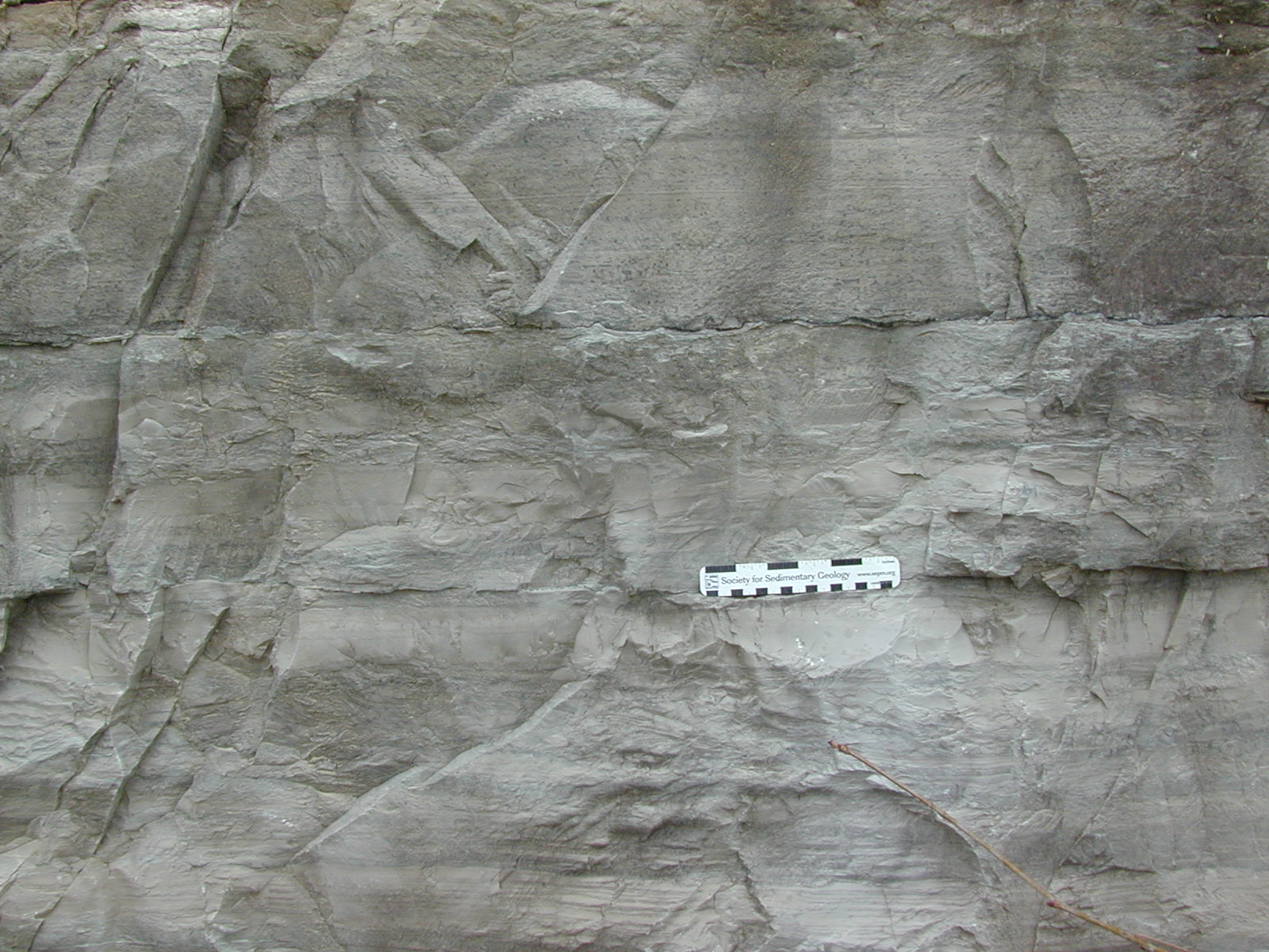
Depositional Settings of Lime Mud

Slide 59
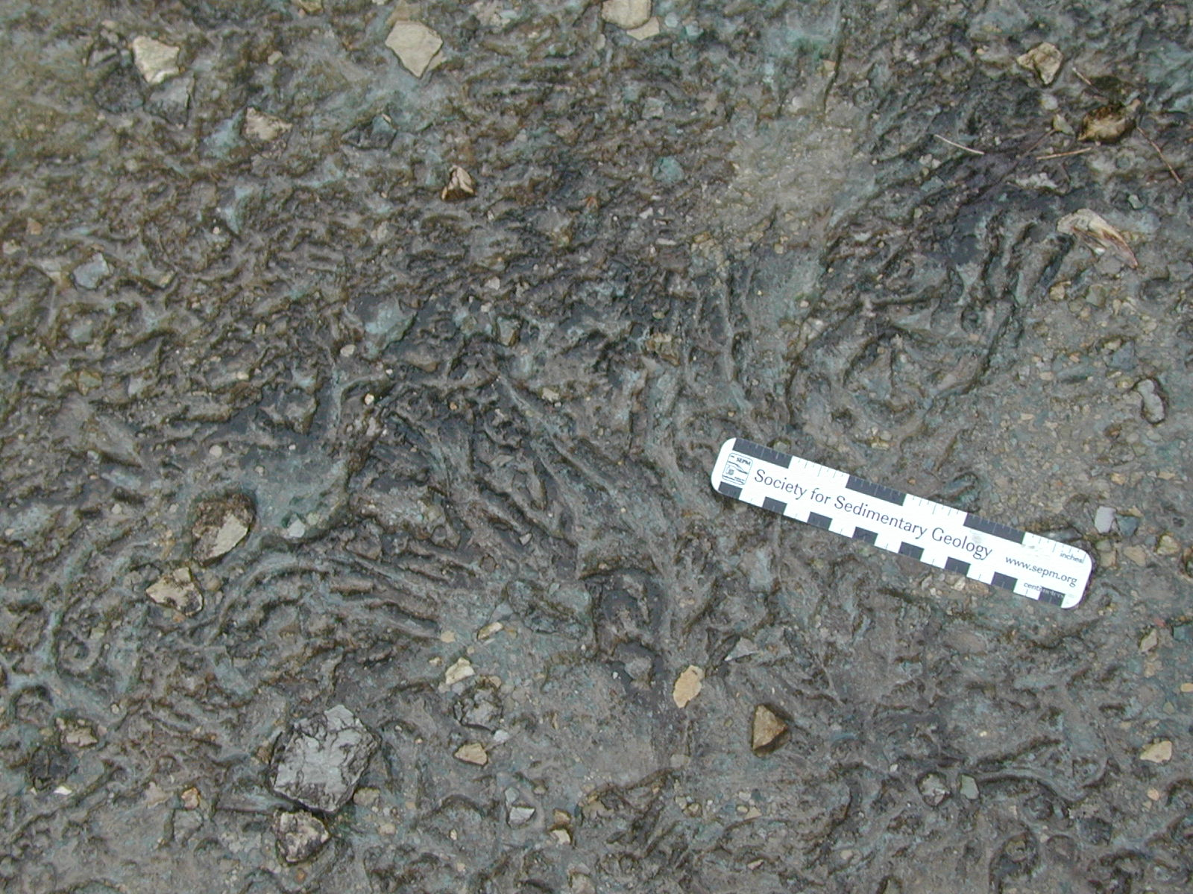
Depositional Settings of Rock Pavement

Slide 60
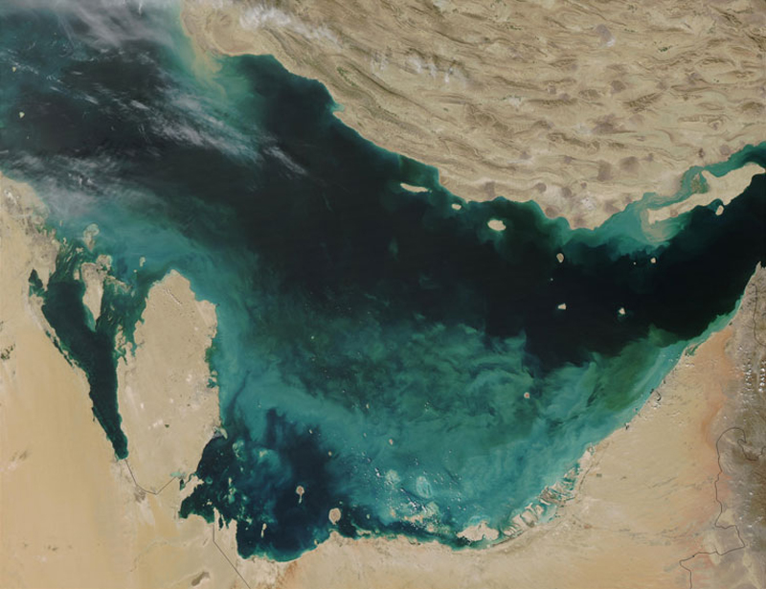
Depositional Setting of Whiting Lime Muds

Slide 61
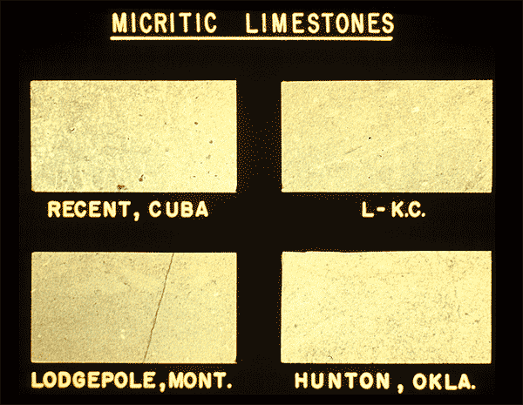
Lime Mud or Micrite

Slide 62
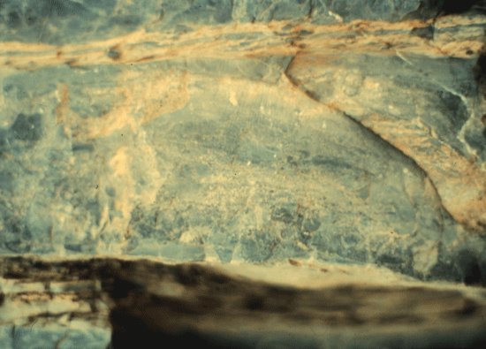
Lime Mud or Micrite on Shelf Margin

Slide 63
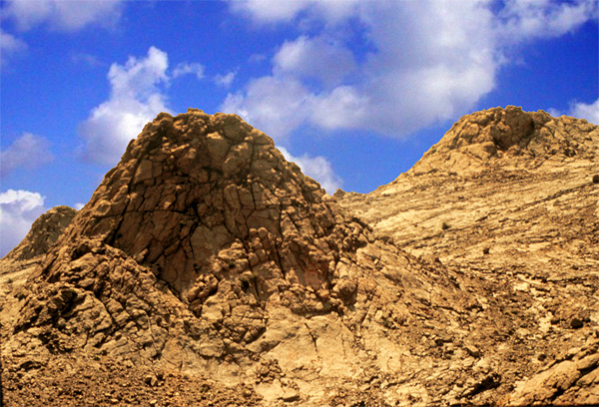
Devonian Micrite Sponge and Bioclastic Reef
Mud Mound Morocco

Slide 64
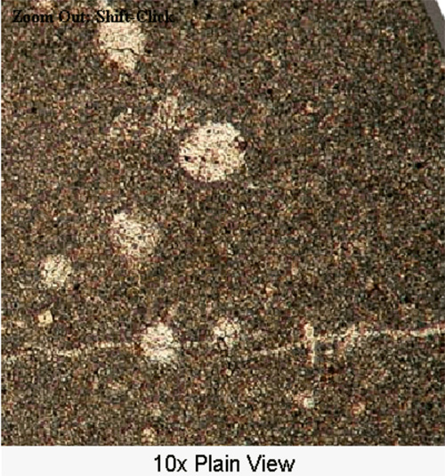
Micrite

Slide 65
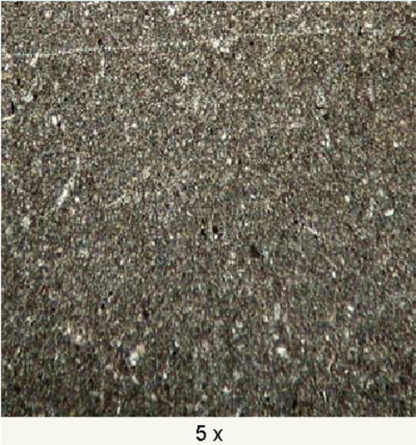
Micrite

Slide 66
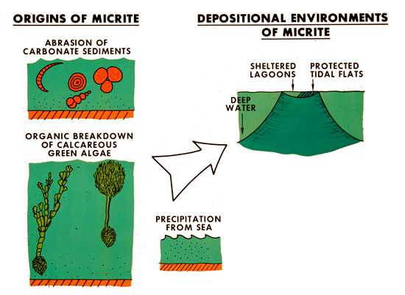
Micrite

Slide 67
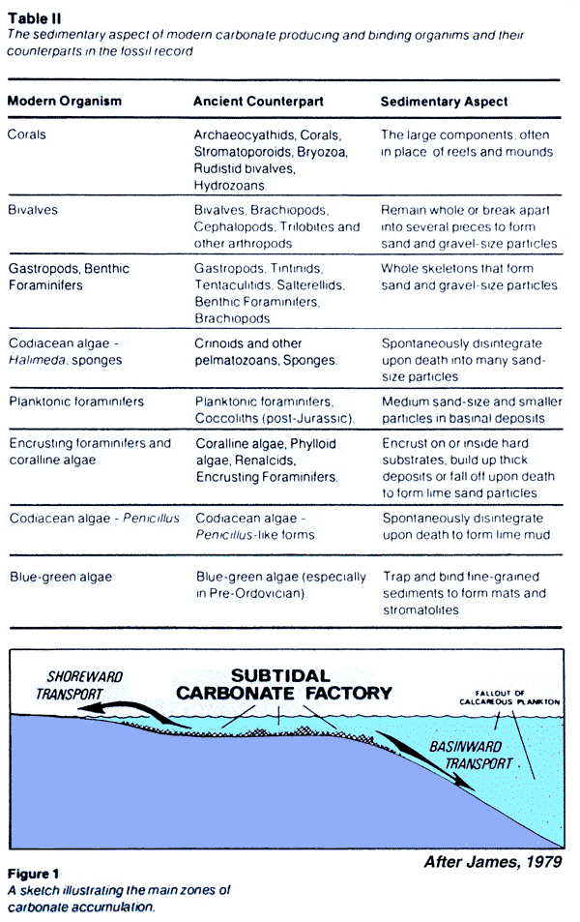
Depositional Setting of Bioclastic Materials

Slide 68
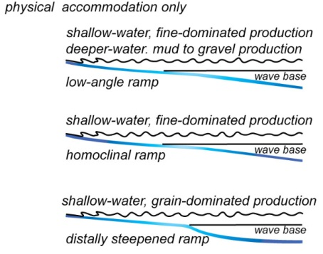
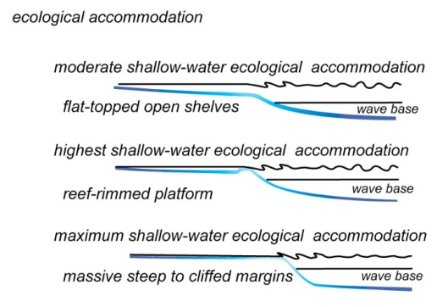
Carbonate Platform Accommodation
physical accommodation only
ecological accommodation

Slide 69
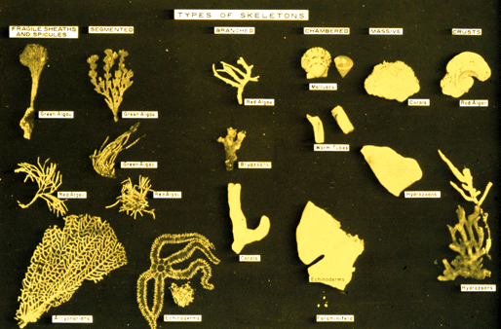
Source of Bioclastic Materials

Slide 70
Skeletal Grains
Commonly composed of calcite, magnesian calcite, aragonite or opaline silica.
Mineralogy determines the susceptibility of the skeletal fragment to diagenetic change and so its current composition and fabric in a limestone or dolomite
Calcite skeletal grains, which contain less than 4 mole % magnesium in the calcite, include some foraminifera, brachiopods, bryozoans, trilobites, ostracodes, calcareous nannoplankton, and tintinnids.
Skeletal grains of magnesian calcite, that is with 4-20 mole % magnesium in the calcite, include those produced by echinoderms, most foraminifera, and red algae.
Aragonite skeletal grains are formed from corals, stromatoporoids, most molluscs, green algae, and blue-green algae. Skeletal grains of biogenic opaline silica include sponge spicules and radiolarians.

Slide 71
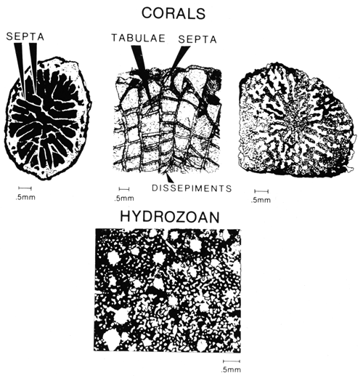
Skeletal Grains - Corals

Slide 72
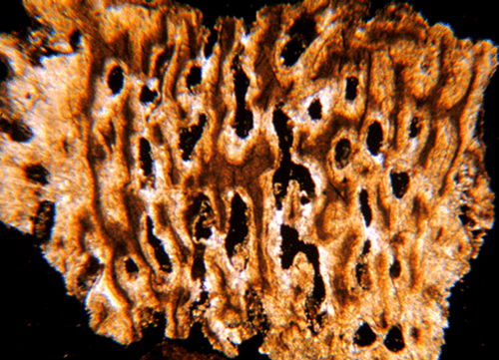
Skeletal Grains - Corals

Slide 73
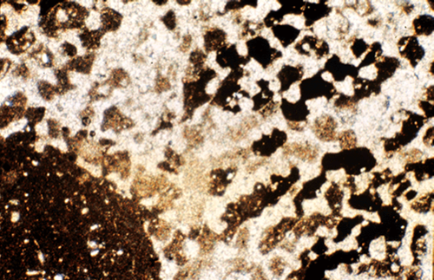
Skeletal Grains - Corals

Slide 74
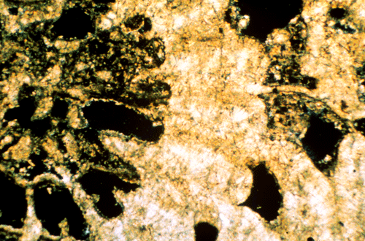
Skeletal Grains - Corals
After Scholle, 2003

Slide 75
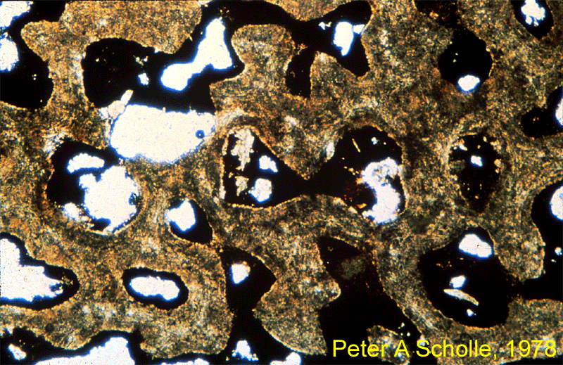
Skeletal Grains - Corals

Slide 76
Skeletal Grains - Corals
After Scholle, 2003

Slide 77
Skeletal Grains - Corals

Slide 78
Skeletal Grains - Corals

Slide 79
Skeletal Grains - Corals

Slide 80
Skeletal Grains - Corals
After Scholle, 2003

Slide 81
Skeletal Grains - Corals

Slide 82
Skeletal Grains – Calcareous Algae

Slide 83
Skeletal Grains – Calcareous Algae

Slide 84
Skeletal Grains – Calcareous Algae

Slide 85
Skeletal Grains – Calcareous Algae

Slide 86
Skeletal Grains – Calcareous Algae

Slide 87
Skeletal Grains – Calcareous Algae
After Scholle, 2003

Slide 88
Skeletal Grains – Cyanobacteria or Algae

Slide 89
Skeletal Grains – Cyanobacteria or Algae

Slide 90
Skeletal Grains – Cyanobacteria or Algae

Slide 91
Skeletal Grains – Cyanobacteria or Algae

Slide 92
Skeletal Grains – Cyanobacteria or Algae

Slide 93
Skeletal Grains – Cyanobacteria or Algae
After Scholle, 2003

Slide 94
Skeletal Grains – Cyanobacterial Oncoids

Slide 95
Skeletal Grains – Cyanobacterial Oncoids

Slide 96
Skeletal Grains – Cyanobacterial Oncoids

Slide 97
Physico Chemical Grains – Pisoids

Slide 98
Physico Chemical Grains – Pisoids
After Scholle, 2003

Slide 99
Physico Chemical Grains – Pisoids

Slide 100
Skeletal Grains – Red Calcareous Algae

Slide 101
Skeletal Grains – Red Calcareous Algae

Slide 102
Skeletal Grains – Red Calcareous Algae

Slide 103
Skeletal Grains – Coccoliths

Slide 104
Skeletal Grains – Coccoliths

Slide 105
Skeletal Grains – Stromatoporids

Slide 106
Skeletal Grains – Stromatoporids

Slide 107
Skeletal Grains – Stromatoporids

Slide 108
Skeletal Grains – Molluscs - Biovalves

Slide 109
Skeletal Grains – Molluscs - Biovalves

Slide 110
Skeletal Grains – Molluscs - Gasteropods

Slide 111
Skeletal Grains – Molluscs - Gasteropods

Slide 112
Skeletal Grains – Molluscs - Gasteropods
After Scholle, 2003

Slide 113
Skeletal Grains – Molluscs - Gasteropods

Slide 114
Skeletal Grains – Molluscs - Gasteropods

Slide 115
Skeletal Grains – Micrite Envelopes

Slide 116
Skeletal Grains – Micrite Envelopes

Slide 117
Skeletal Grains – Micrite Envelopes

Slide 118
Skeletal Grains – Echinoid Fragments

Slide 119
Skeletal Grains – Echinoid Fragments
After Scholle, 2003

Slide 120
Skeletal Grains – Echinoid Fragments

Slide 121
Skeletal Grains – Echinoid Fragments
After Scholle, 2003

Slide 122
Skeletal Grains – Echinoid Fragments
After Scholle, 2003

Slide 123
Skeletal Grains – Echinoid Fragments

Slide 124
Skeletal Grains – Echinoid Fragments
After Scholle, 2003

Slide 125
Skeletal Grains – Echinoid Fragments

Slide 126
Skeletal Grains – Echinoid Fragments

Slide 127
Skeletal Grains – Echinoid Fragments

Slide 128
Skeletal Grains – Echinoid Fragments
After Scholle, 2003

Slide 129
Skeletal Grains – Echinoid Fragments

Slide 130
Skeletal Grains – Sponge Spicules

Slide 131
Skeletal Grains – Sponge Spicules

Slide 132
Skeletal Grains – Byozoan

Slide 133
Skeletal Grains – Byozoan

Slide 134
Skeletal Grains – Byozoan

Slide 135
Skeletal Grains – Byozoan

Slide 136
Skeletal Grains – Byozoan

Slide 137
Skeletal Grains – Byozoan

Slide 138
Skeletal Grains – Byozoan
After Scholle, 2003

Slide 139
Skeletal Grains – Byozoan

Slide 140
Skeletal Grains – Byozoan

Slide 141
Skeletal Grains – Brachiopods

Slide 142
Skeletal Grains – Brachiopods

Slide 143
Skeletal Grains – Brachiopods

Slide 144
Skeletal Grains – Brachiopods

Slide 145
Skeletal Grains – Brachiopods
After Scholle, 2003

Slide 146
Skeletal Grains – Brachiopods
After Scholle, 2003

Slide 147
Skeletal Grains – Brachiopods

Slide 148
Skeletal Grains – Foraminifera

Slide 149
Skeletal Grains – Foraminifera

Slide 150
Skeletal Grains – Foraminifera

Slide 151
Skeletal Grains – Foraminifera

Slide 152
Skeletal Grains – Foraminifera - Fuslinids

Slide 153
Skeletal Grains – Foraminifera
After Scholle, 2003

Slide 154
Skeletal Grains – Foraminifera - Fusilinids

Slide 155
Skeletal Grains – Foraminifera - Numulitids
After Scholle, 2003

Slide 156
Skeletal Grains – Arthropods

Slide 157
Skeletal Grains – Arthropods - Trilobites

Slide 158
Skeletal Grains – Arthropods - Trilobites

Slide 159
Skeletal Grains – Arthropods - Trilobites

Slide 160
Skeletal Grains – Arthropods - Trilobites

Slide 161
Skeletal Grains – Arthropods - Trilobites

Slide 162
Skeletal Grains – Arthropods - Ostracods

Slide 163
Skeletal Grains – Arthropods - Ostracods

Slide 164
Carbonate Bio-Physico-Chemical Grains
Ooids
Grapestones and other intraclasts
Pellets
Pisolites and Oncolites

Slide 165
Carbonate Bio-Physico-Chemical Grains

Slide 166
Carbonate Bio-Physico-Chemical Grains

Slide 167
Carbonate Bio-Physico-Chemical Grains

Slide 168
Halat Al Baraini – Ooid Ebb Delta

Slide 169
Halat Al Baraini – Ooid Ebb Delta

Slide 170
Halat Al Baraini – Ooid Ebb Delta

Slide 171
Halat Al Baraini – Ooid Ebb Delta

Slide 172
Ooids

Slide 173
Ooid Grains

Slide 174
Ooid Grains

Slide 175
Ooid Grains

Slide 176
Ooid Grains

Slide 177
Aragonite Ooid Grains

Slide 178
Aragonite Ooid Grains of Bahamian Margin

Slide 179
Aragonite Ooid Grains of Bahamian Margin

Slide 180
Aragonite Ooid Grains of Bahamian Margin

Slide 181
Aragonite Ooid Grains of Bahamian Margin
After Scholle, 2003

Slide 182
Aragonite Ooid Grains of Bahamian Margin

Slide 183
Calcite & Aragonite Ooids of Great Salt Lake

Slide 184
Quiet Water Ooids

Slide 185
Calcite & Aragonite Ooids of Great Salt Lake
After Scholle, 2003

Slide 186
Calcitic Ooids – Carboniferous Australia

Slide 187
Aragonite Ooid Pseudo-morphed in Ordovician

Slide 188
Calcitic Ooids

Slide 189
Radial Calcite Ooids

Slide 190
Radial Calcite Ooid

Slide 191
Radial Calcite Ooids

Slide 192
Radial Calcite Ooids

Slide 193
Radial Calcite Ooids

Slide 194
Grapestone Formation

Slide 195
Grapestone Formation

Slide 196
Grapestones from Bahamas

Slide 197
Grapestones Forming in Bahamas

Slide 198
Grapestones and Botryoidal Grains
After Scholle, 2003

Slide 199
Intraclast Formation on Tidal Flats

Slide 200
Intraclast Formation Tidal Flats - Bahamas

Slide 201
Intraclast Formation on Tidal Flats
Intraclasts
–
Mud Flakes
-
Permian
West Texas
-
Dark
Canyon

Slide 202
Intraclast Formation on Tidal Flats

Slide 203
Grapestone Formation on Shoals

Slide 204
Extraclast Formation on Subaerial Surface

Slide 205
Extraclasts

Slide 206
Extraclast Formation on Subaerial Surface

Slide 207
Pellet Formation in Shallow Protected Waters

Slide 208
Faecal Pellets from Shallow Protected Waters

Slide 209
Pellets from Shallow Protected Waters

Slide 210
Peloids from Shallow Protected Waters

Slide 211
Peloids from Shallow Protected Waters

Slide 212
Peloids from Shallow Protected Waters

Slide 213
Peloid Forming From Foraminifera

Slide 214
Peloids or Pellets?

Slide 215
Peloids or Pellets?

Slide 216
Peloids or Pellets?

Slide 217
Peloids or Pellets?

Slide 218
Peloids or Pellets?

Slide 219
Coarse Dolomite Crystals

Slide 220
Coarse Dolomite Rhombs

Slide 221
Chert Replacement of Ooids

Slide 222
Carbonate Settings & Facies Hierarchies
The sequence stratigraphic framework is used to:
Interpret carbonate depositional settings
Predict facies and geometric hierarchies of potential carbonate plays & reservoir models.
Through geologic time carbonate depositional systems have common critical elements in sedimentary character determined by the processes operating from the deep basin to inner updip shelf.
Over simple relationships are used to predict potential carbonate plays & reservoir models.

Slide 223
Hierarchy of Carbonate Architectural Elements

Slide 224
Hierarchy of Carbonate Architectural Elements

Slide 225
Hierarchy of Carbonate Architectural Elements

Slide 226
Hierarchy of Carbonate Architectural Elements

Slide 227
Hierarchy of Carbonate Architectural Elements

Slide 228
Controls on Carbonate Accumulation Rates
”Carbonate Hierarchies”
Christopher G. St. C. Kendall

Slide 229
Sea Level Controls Carbonate Geometries
”Carbonate Hierarchies”
Christopher G. St. C. Kendall

Slide 230
Dominant Processes of Carbonate Settings
PHYSIOGRAPHIC AREA | PROCESSES
S H E L F | RESTRICTED “LANDWARD EDGE” | WIND-DRIVEN WAVES TIDAL EXCHANGE Biological activity
 | OPEN MARINE “SHELF MIDDLE” | WIND, WAVES, AND CURRENTS SLOW TIDAL CURRENTS Biological activity
 | MARGIN “SHELF MARGIN” | TIDAL EXCHANGE BIOLOGICAL ACTIVITY WAVE THRUST
SLOPE |  | GRAVITY
BASIN |  | GRAVITY DEEP- SEA CURRENTS

Slide 231
Setting | Inner Shelf | Outer Shelf | Margin | Slope | Basin
Facies | Sediment homogeneous – Muds, pellets to bioclastic packstone to wackestone; local evaporites Shoaling upward cycles common, predictable & correlatable finer carbonate capped by tidal-flat dominated by cyanobacteria &/or evaporites | Sediment heterogeneous: ooids, grapestones & hardened pellets to bioclastic grain shoals to patch reef & shoal build ups Shoaling upward cycles common, predictable and correlatable | Sediments heterogeneous to homogenous bioclastic packstone to grainstone accumulations Shoaling upward cycles common | Upslope: Heterogeneous wackestones to packstones to grainstone & rudstone offbank transport Lime mudstone-wackestone from fine-grained periplatform shedding & quiescent foreslope Local presence of well-sorted grain-rich tempestites Brittle reef failure & debris of breccias and blocks (olistoliths) common Down slope homogenous dispersed bioclastic packstone to mudstone from upslope, often bioturbated Fining upward cycles common | Homogenous vertical cycles of mudstone, marl to shale, from eustatic changes Fining upward cycles common
Geometry | Unconfined sheets of homogeneous sediment Local storm driven confined channel fill | Unconfined heterogeneous sediment sheets Local confined channel fill Local confined lens shaped build ups | Unconfined thick to massive homogeneous sheets to linear bodies parallel (barrier shoals) perpendicular (tidal channels) to margin | Interfingering unconfined aggrade & retrograde of foreslope clinoform sheets; thick upslope/thin downslope Local confined sheets and channel fill can be common | unconfined thin widespread sheets
Fauna | Fauna often high numbers & restricted | Fauna commonly shallow water, heterogeneous and moderately cosmopolitan | Fauna high numbers & cosmopolitan Downslope ecological accommodation common with massive boundstones & heterogeneous open-marine ‘reef-building’ skeletal materials often grain-prone in distal portions; upper bounding surfaces often SB & less visible mfs | Fauna high numbers upslope but sparser & restricted downslope Bioturbation cosmopolitan in shallows protected from heavy wave action; in deeper upper slope burrowing often intense | Fauna low numbers & sparse away from margin Bioturbation common on surfaces with low supply rates
LST | FSST & subsequent LST exposure SBs, potential karstification &/or no accumulation | FSST and LST common exposure surfaces & discontinuous mudstone to wackestone fill of incised tidal channels perpendicular to margin overlain by discontinuous to continuous microbial flat sheets | FSST & LST include exposure surfaces, or, where sea-level fall less, forced regressions of packstone and wackestone facies of shoreline bodies of upper slope area (perched parasequences) parallel to margin | FSST & lowstand LST erosional surfaces from sediment bypass from upslope, downslope from forced regressive shorelines with wackestone and packstone facies extending downslope from the basin margin FSST/LST collapse margin megabreccias at sea-level falls | LST and TST (& early HST) when platforms aggrade rapidly they & slope supply debris & mud flows
TST | TST often missing or reworked earlier sediments | TST onlapping linear sheets parallel to margin with local aggradation of TST lenses | TST onlapping sheets of open-marine facies of mudstones, wackestones & packstone sheets | TST onlapping sheets of open-marine facies of argillaceous lime mudstone and wackestone; local buildups, especially over topographic highs | LST and TST (& early HST) when platforms aggrade rapidly they & slope supply debris & mud flows
HST | HST base of organic-rich argillaceous carbonate or shale | HST elevated aggradational, linear, ribbons of lime-sand barriers and shoals parallel to margin capped by subaerial SBs | HST base of finer lime mudstones & wackestones, & overlain by aggrading shoaling-up cycles of grainstone ribbons parallel to the platform margin & massive merging boundstone parallel to margin capped by subaerial SB | HST lime mudstone to wackestone sheets from margin, SB erosional to subaerial unconformity caps | HST platform shedding, grain-flow, density-flow & turbidite sands & less lime mud. Lower slope thinning-thickening upward calciturbidites metre-scale & upwards beds, product of millennial eustatic or climatic change

Slide 232
Carbonate Depositional Settings Shelf to Basin

Slide 233
Lecture Conclusions
Shelf has wide spread continuous sheets that tend to shoal up
Outer shelf:- heterogeneous carbonates with mix of linear bodies parallel to basin & perpendicular to it! Local build up lenses.
Inner shelf:- dominated by mud prone sheets with evaporites & or clastic channels and sheets
Margin: Massive and heterogeneous, most porous but least prone to seal
Down slope sheets that thin down slope & may be grain prone in distal portions
Basinal couplets of mud and shale from mix of pelagic and shelf sources.

Slide 234
Lecture Ends!!
and so for a glass of lemonade!

